Slide 1
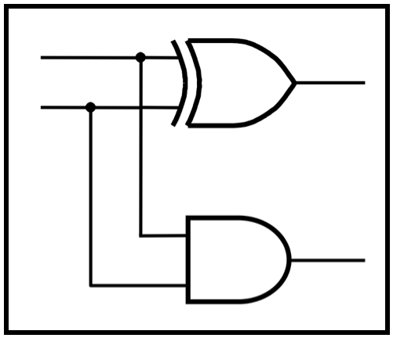
CprE 281:
Digital Logic
Instructor: Alexander Stoytchev
http://www.ece.iastate.edu/~alexs/classes/

Slide 2
Synchronous Sequential Circuits
Basic Design Steps
CprE 281: Digital Logic
Iowa State University, Ames, IA
Copyright © Alexander Stoytchev

Slide 3
First Design Pattern:
Moore Machines

Slide 4
Moore Machine:
A Type of Finite State Machine (FSM)
Reset
w
=
1
w
=
0
A: z = 0
B: z = 0
w
=
0
w
=
0
w
=
1
C: z = 1
w
=
1
[ Figure 6.3 from the textbook ]

Slide 5
Reset
w
=
1
w
=
0
A: z = 0
B: z = 0
w
=
0
w
=
0
w
=
1
C: z = 1
w
=
1
Finite number of states (nodes).
Discrete state transitions (edges).
Only “in” one state at a time.
One reset state
Every state has an outgoing state transition for each possible input.
[ Figure 6.3 from the textbook ]

Slide 6
Reset
w
=
1
w
=
0
A: z = 0
B: z = 0
w
=
0
w
=
0
w
=
1
C: z = 1
w
=
1
Key: The next state depends on both the current state and the current input.
[ Figure 6.3 from the textbook ]

Slide 7
Reset
w
=
1
w
=
0
A: z = 0
B: z = 0
w
=
0
w
=
0
w
=
1
C: z = 1
w
=
1
Key: The output depends only on the current state.
[ Figure 6.3 from the textbook ]

Slide 8
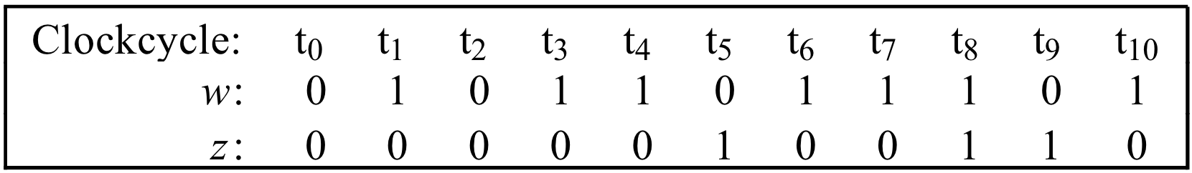
Reset
w
=
1
w
=
0
A: z = 0
B: z = 0
w
=
0
w
=
0
w
=
1
C: z = 1
w
=
1

Slide 9
Reset
w
=
1
w
=
0
A: z = 0
B: z = 0
w
=
0
w
=
0
w
=
1
In general, we need to start tracing from the beginning to know which state the FSM is in. It may not be clear from a short sequence of outputs.
C: z = 1
w
=
1

Slide 10
Reset
w
=
1
w
=
0
A: z = 0
B: z = 0
w
=
0
w
=
0
w
=
1
C: z = 1
What is the meaning of each state?
w
=
1

Slide 11
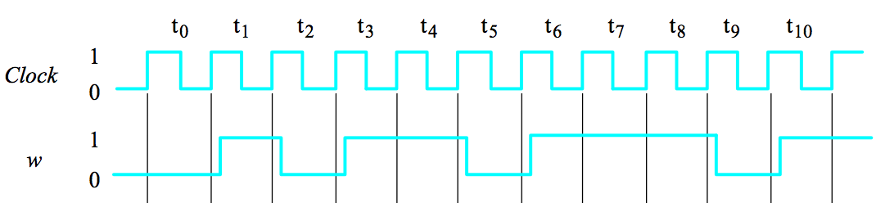
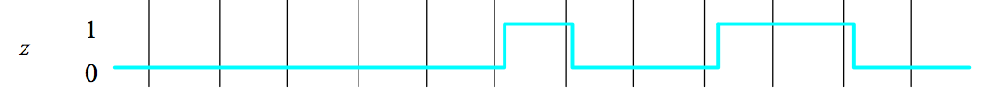

Slide 12
What is a State?
It is not really a memory of every past input
(We might run out of space to remember it all!)
Rather, it is a characterization or snapshot of the pattern of inputs that have come before.

Slide 13
Moore Machine Implementation
The state diagram is just an illustration to help us describe and reason about how the FSM will behave in each of its states.
So, how do we turn it into a circuit?

Slide 14
Moore Machine Implementation
W
Combinational
Memory Elements
Combinational
circuit
Z
circuit
Clock
Note: The W and Z lines need not be wires. They can be buses.
[ Figure 6.1 from the textbook ]

Slide 15
State Storage
W
Combinational
Q(t+1)
Flip-Flop Array
Q(t)
Combinational
circuit
Z
circuit
Clock
Any usable “memory” of the preceding input sequence
is encoded in the flip-flop array.

Slide 16
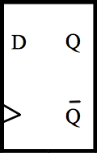
FSM States
The Flip-Flop array stores an encoding of the current state.
Q(t)
Q(t+1)
Clock

Slide 17
State Encoding
Each of the states in our design is identified by a distinct code.
If we use 3 flip-flops, then the FSM can have up to 2³ = 8 distinct states.
So, when the flip-flop array contains the code 011, we say that the machine is in state 011.

Slide 18
Synchronous Design
W
Combinational
Q(t+1)
Flip-Flop Array
Q(t)
Combinational
circuit
Z
circuit
Clock
Every active clock edge causes a state transition.

Slide 19
Synchronous Design
W
Combinational
Q(t+1)
Flip-Flop Array
Q(t)
Combinational
circuit
Z
circuit
Clock
We expect the input signals to be stable
before the active clock edge occurs.

Slide 20
Synchronous Design
W
Combinational
Q(t+1)
Flip-Flop Array
Q(t)
Combinational
circuit
Z
circuit
Clock
There is a whole other class of sequential circuits which are asynchronous, but we will not study them in this course.

Slide 21
Sequential Circuits: Key Ideas
The current output depends on something about the preceding sequence of inputs (and maybe the current output).
Using memory elements (i.e., flip-flops), we design the circuit to remember some relevant information about the prior inputs.

Slide 22
Example

Slide 23
Reset
w
=
1
w
=
0
A: z = 0
B: z = 0
w
=
0
w
=
0
w
=
1
C: z = 1
w
=
1
We need to find both the next state logic and the output logic implied by this machine.
[ Figure 6.3 from the textbook ]

Slide 24
Reset
w
=
1
w
=
0
A: z = 0
B: z = 0
w
=
0
w
=
0
w
=
1
C: z = 1
w
=
1
Present
Next state
Output
state
w
=
0
w
=
1
z
A
B
C

Slide 25
Reset
w
=
1
w
=
0
A: z = 0
B: z = 0
w
=
0
w
=
0
w
=
1
C: z = 1
w
=
1
Present
Next state
Output
state
w
=
0
w
=
1
z
A
A
B
0
B
A
C
0
C
A
C
1
[ Figure 6.4 from the textbook ]

Slide 26
How to represent the States?
One way is to encode each state with a 2-bit binary number
A ~ 00
B ~ 01
C ~ 10

Slide 27
How to represent the states?
One way is to encode each state with a 2-bit binary number
A ~ 00
B ~ 01
C ~ 10
How many flip-flops do we need?

Slide 28
Let’s use two flip flops to hold the machine’s state

Slide 29
Y
y
1
1
Y
y
2
2
Clock

Slide 30
Y
y
1
1
Y
y
2
2
Clock
We will call y₁ and y₂ the present state variables.
We will call Y₁ and Y₂ the next state variables.
[ Figure 6.5 from the textbook ]

Slide 31
0
Y
y
1
1
0
Y
y
2
2
Clock
Two zeros on the output JOINTLY represent state A.

Slide 32
1
Y
y
1
1
0
Y
y
2
2
Clock
This flip-flop output pattern represents state B.

Slide 33
0
Y
y
1
1
1
Y
y
2
2
Clock
This flip-flop output pattern represents state C.

Slide 34
1
Y
y
1
1
1
Y
y
2
2
Clock
What does this flip-flop output pattern represent?

Slide 35
1
Y
y
1
1
1
Y
y
2
2
Clock
This would be state D, but we don't have one
in this example. So this is an impossible state.

Slide 36
Y
y
w
1
1
Next State Logic
Output Logic
z
Y
y
2
2
Clock
[ Figure 6.5 from the textbook ]

Slide 37
Q(t+1) = Y₂Y₁
Q(t) = y₂y₁
Y
y
w
1
1
Next State Logic
Output Logic
z
Y
y
2
2
Clock
We will call y₁ and y₂ the present state variables.
We will call Y₁ and Y₂ the next state variables.
[ Figure 6.5 from the textbook ]

Slide 38
Y
y
w
1
1
Next State Logic
Output Logic
z
Y
y
2
2
Clock
We need to find logic expressions for
Y₁(w, y₁, y₂), Y₂(w, y₁, y₂), and z(y₁, y₂).
[ Figure 6.5 from the textbook ]

Slide 39
Y
y
w
1
1
Next State Logic
Output Logic
z
Y
y
2
2
Clock
We need to find logic expressions for
Y₁(w, y₁, y₂), Y₂(w, y₁, y₂), and z(y₁, y₂).
[ Figure 6.5 from the textbook ]

Slide 40
Present
Next state
Output
state
w
=
0
w
=
1
z
A
A
B
0
B
A
C
0
C
A
C
1
Suppose we encoded our states in the same order in which they were labeled:
A ~ 00
B ~ 01
C ~ 10
[ Figure 6.4 from the textbook ]

Slide 41
Present
Next state
Output
state
w
=
0
w
=
1
z
A
A
B
0
B
A
C
0
C
A
C
1
Next state
Present
w
=
0
w
=
1
Output
state
z
A
00
The finite state machine will never reach a state encoded as 11.
B
01
C
10
11
[ Figure 6.6 from the textbook ]

Slide 42
Present
Next state
Output
state
w
=
0
w
=
1
z
A
A
B
0
B
A
C
0
C
A
C
1
Next state
Present
w
=
0
w
=
1
Output
state
z
y
2
y
1
Y
2
Y
1
Y
2
Y
1
We arbitrarily chose these as our state encodings. We could have used others.
A
00
00
01
0
B
01
00
10
0
C
10
00
10
1
11
dd
dd
d
[ Figure 6.6 from the textbook ]

Slide 43
Q(t) = y₂y₁ and Q(t+1) = Y₂Y₁
w | y₂ | y₁ | Y₂ | Y₁
0 | 0 | 0
0 | 0 | 1
0 | 1 | 0
0 | 1 | 1
1 | 0 | 0
1 | 0 | 1
1 | 1 | 0
1 | 1 | 1
Next state
Present
w
=
0
w
=
1
Output
state
z
y
2
y
1
Y
2
Y
1
Y
2
Y
1
00
00
01
0
01
00
10
0
10
00
10
1
11
dd
dd
d
y₂ | y₁ | z
0 | 0
0 | 1
1 | 0
1 | 1
[ Figure 6.6 from the textbook ]

Slide 44
Q(t) = y₂y₁ and Q(t+1) = Y₂Y₁
w | y₂ | y₁ | Y₂ | Y₁
0 | 0 | 0
0 | 0 | 1
0 | 1 | 0
0 | 1 | 1
1 | 0 | 0
1 | 0 | 1
1 | 1 | 0
1 | 1 | 1
Next state
Present
w
=
0
w
=
1
Output
state
z
y
2
y
1
Y
2
Y
1
Y
2
Y
1
00
00
01
0
01
00
10
0
10
00
10
1
11
dd
dd
d
y₂ | y₁ | z
0 | 0 | 0
0 | 1 | 0
1 | 0 | 1
1 | 1 | d
[ Figure 6.6 from the textbook ]

Slide 45
Q(t) = y₂y₁ and Q(t+1) = Y₂Y₁
w | y₂ | y₁ | Y₂ | Y₁
0 | 0 | 0
0 | 0 | 1
0 | 1 | 0
0 | 1 | 1
1 | 0 | 0
1 | 0 | 1
1 | 1 | 0
1 | 1 | 1
Next state
Present
w
=
0
w
=
1
Output
state
z
y
2
y
1
Y
2
Y
1
Y
2
Y
1
00
00
01
0
01
00
10
0
10
00
10
1
11
dd
dd
d
y₂ | y₁ | z
0 | 0 | 0
0 | 1 | 0
1 | 0 | 1
1 | 1 | d
[ Figure 6.6 from the textbook ]

Slide 46
Q(t) = y₂y₁ and Q(t+1) = Y₂Y₁
w | y₂ | y₁ | Y₂ | Y₁
0 | 0 | 0 | 0
0 | 0 | 1 | 0
0 | 1 | 0 | 0
0 | 1 | 1 | d
1 | 0 | 0
1 | 0 | 1
1 | 1 | 0
1 | 1 | 1
Next state
Present
w
=
0
w
=
1
Output
state
z
y
2
y
1
Y
2
Y
1
Y
2
Y
1
00
00
01
0
01
00
10
0
10
00
10
1
11
dd
dd
d
y₂ | y₁ | z
0 | 0 | 0
0 | 1 | 0
1 | 0 | 1
1 | 1 | d
[ Figure 6.6 from the textbook ]

Slide 47
Q(t) = y₂y₁ and Q(t+1) = Y₂Y₁
w | y₂ | y₁ | Y₂ | Y₁
0 | 0 | 0 | 0
0 | 0 | 1 | 0
0 | 1 | 0 | 0
0 | 1 | 1 | d
1 | 0 | 0 | 0
1 | 0 | 1 | 1
1 | 1 | 0 | 1
1 | 1 | 1 | d
Next state
Present
w
=
0
w
=
1
Output
state
z
y
2
y
1
Y
2
Y
1
Y
2
Y
1
00
00
01
0
01
00
10
0
10
00
10
1
11
dd
dd
d
y₂ | y₁ | z
0 | 0 | 0
0 | 1 | 0
1 | 0 | 1
1 | 1 | d
[ Figure 6.6 from the textbook ]

Slide 48
Q(t) = y₂y₁ and Q(t+1) = Y₂Y₁
w | y₂ | y₁ | Y₂ | Y₁
0 | 0 | 0 | 0
0 | 0 | 1 | 0
0 | 1 | 0 | 0
0 | 1 | 1 | d
1 | 0 | 0 | 0
1 | 0 | 1 | 1
1 | 1 | 0 | 1
1 | 1 | 1 | d
Next state
Present
w
=
0
w
=
1
Output
state
z
y
2
y
1
Y
2
Y
1
Y
2
Y
1
00
00
01
0
01
00
10
0
10
00
10
1
11
dd
dd
d
y₂ | y₁ | z
0 | 0 | 0
0 | 1 | 0
1 | 0 | 1
1 | 1 | d
[ Figure 6.6 from the textbook ]

Slide 49
Q(t) = y₂y₁ and Q(t+1) = Y₂Y₁
w | y₂ | y₁ | Y₂ | Y₁
0 | 0 | 0 | 0 | 0
0 | 0 | 1 | 0 | 0
0 | 1 | 0 | 0 | 0
0 | 1 | 1 | d | d
1 | 0 | 0 | 0
1 | 0 | 1 | 1
1 | 1 | 0 | 1
1 | 1 | 1 | d
Next state
Present
w
=
0
w
=
1
Output
state
z
y
2
y
1
Y
2
Y
1
Y
2
Y
1
00
00
01
0
01
00
10
0
10
00
10
1
11
dd
dd
d
y₂ | y₁ | z
0 | 0 | 0
0 | 1 | 0
1 | 0 | 1
1 | 1 | d
[ Figure 6.6 from the textbook ]

Slide 50
Q(t) = y₂y₁ and Q(t+1) = Y₂Y₁
w | y₂ | y₁ | Y₂ | Y₁
0 | 0 | 0 | 0 | 0
0 | 0 | 1 | 0 | 0
0 | 1 | 0 | 0 | 0
0 | 1 | 1 | d | d
1 | 0 | 0 | 0 | 1
1 | 0 | 1 | 1 | 0
1 | 1 | 0 | 1 | 0
1 | 1 | 1 | d | d
Next state
Present
w
=
0
w
=
1
Output
state
z
y
2
y
1
Y
2
Y
1
Y
2
Y
1
00
00
01
0
01
00
10
0
10
00
10
1
11
dd
dd
d
y₂ | y₁ | z
0 | 0 | 0
0 | 1 | 0
1 | 0 | 1
1 | 1 | d
[ Figure 6.6 from the textbook ]

Slide 51
Q(t) = y₂y₁ and Q(t+1) = Y₂Y₁
w | y₂ | y₁ | Y₂ | Y₁
0 | 0 | 0 | 0 | 0
0 | 0 | 1 | 0 | 0
0 | 1 | 0 | 0 | 0
0 | 1 | 1 | d | d
1 | 0 | 0 | 0 | 1
1 | 0 | 1 | 1 | 0
1 | 1 | 0 | 1 | 0
1 | 1 | 1 | d | d
Next state
Present
w
=
0
w
=
1
Output
state
z
y
2
y
1
Y
2
Y
1
Y
2
Y
1
00
00
01
0
01
00
10
0
10
00
10
1
11
dd
dd
d
y₂ | y₁ | z
0 | 0 | 0
0 | 1 | 0
1 | 0 | 1
1 | 1 | d
[ Figure 6.6 from the textbook ]

Slide 52
Note that the textbook draws these K-Maps
differently from all previous K-maps
(the least significant bits index the columns,
instead of the most significant bits).
Q(t) = y₂y₁ and Q(t+1) = Y₂Y₁
Y ₁
y
y
w | y₂ | y₁ | Y₂ | Y₁
0 | 0 | 0 | 0 | 0
0 | 0 | 1 | 0 | 0
0 | 1 | 0 | 0 | 0
0 | 1 | 1 | d | d
1 | 0 | 0 | 0 | 1
1 | 0 | 1 | 1 | 0
1 | 1 | 0 | 1 | 0
1 | 1 | 1 | d | d
2
1
w
00
01
11
10
0
0
0
d
0
1
1
0
d
0
Y ₂
y
y
2
1
w
00
01
11
10
0
0
0
d
0
1
0
1
d
1
y₂ | y₁ | z
0 | 0 | 0
0 | 1 | 0
1 | 0 | 1
1 | 1 | d
z
y
y
1
2
0
1
0
0
0
1
1
d

Slide 53
Don’t care conditions simplify the combinatorial logic
Y ₁
y
y
2
1
Ignoring don't cares
Using don't cares
w
00
01
11
10
0
0
0
d
0
Y
=
wy
y
Y
=
wy
y
1
1
2
1
1
2
1
1
0
d
0
Y ₂
y
y
2
1
w
00
01
11
10
0
0
0
d
0
Y
=
wy
y
2
+
wy
y
Y
=
wy
+
wy
2
1
1
2
2
1
2
1
=
w
(
y
1
+
y
2
)
0
1
d
1
z
y
y
1
2
0
1
0
0
0
z
=
y
1
y
2
z
=
y
2
1
1
d
[ Figure 6.7 from the textbook ]

Slide 54
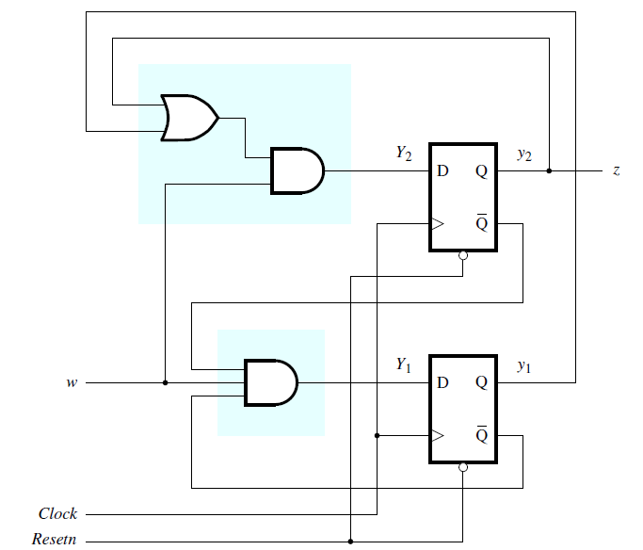
[ Figure 6.8 from the textbook ]

Slide 55
Y₂= w (y1 + y2)
z = y2
Y₁= w y1 y2
[ Figure 6.8 from the textbook ]

Slide 56
Lastly, we add a reset signal, which forces the machine back to its start state, which is state 00 in this case.
[ Figure 6.8 from the textbook ]

Slide 57
t
0
t
1
t
2
t
3
t
4
t
5
t
6
t
7
t
8
t
9
t
10
1
Clock
0
1
w
0
1
y
1
0
1
y
2
0
1
z
0
[ Figure 6.9 from the textbook ]

Slide 58
Summary: Designing a Moore Machine
Obtain the circuit specification.
Derive a state diagram.
Derive the state table.
Decide on a state encoding.
Encode the state table.
Derive the output logic and next-state logic.
Add a reset signal.

Slide 59
Questions?

Slide 60
THE END

